Slide 1
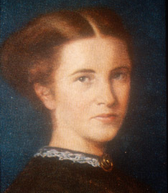
Elizabeth Garrett Anderson

Slide 2
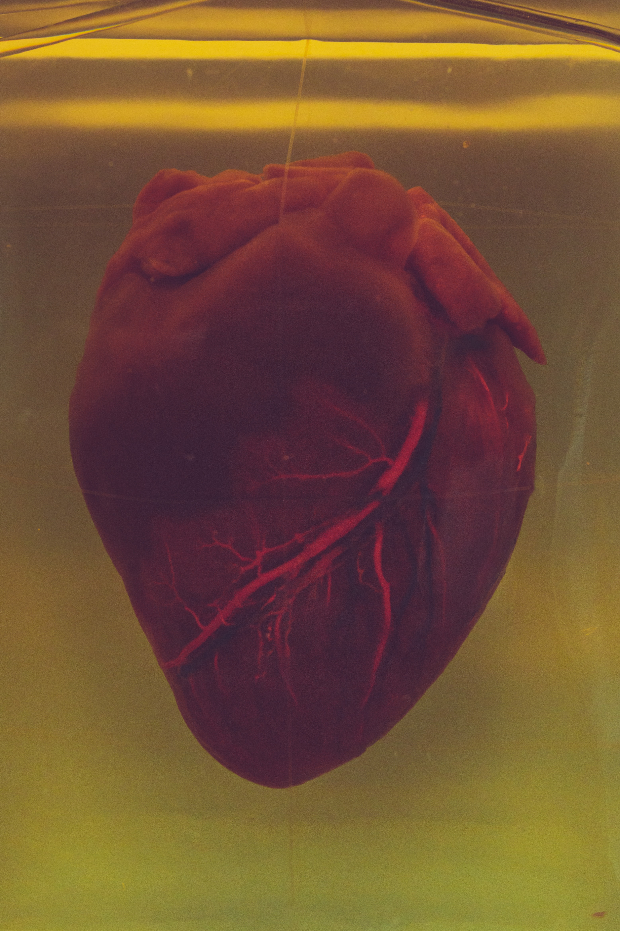
Draw the heart as accurately as you can.
Slide 1

Slide 3
What is different about a hospital bed?
Slide 2

Slide 4
Photo Credits: Photo of the heart –Unsplash Picture of Elizabeth and hospital bed – Wikipedia –public domain
© HMDT Music 2020

